Slide 1
Predictive Analytics
&
Predictive Modelling

Slide 2
What is Predictive Modelling
Predictive analytics is the branch of the advanced analytics which is used to make predictions about unknown future events. Predictive analytics uses many techniques from data mining, statistics, modeling, machine learning, and artificial intelligence to analyze current data to make predictions about future.
Predictive modeling is a process used in predictive analytics to create a statistical model of future behavior. Predictive analytics is the area of data mining concerned with forecasting probabilities and trends.

Slide 3
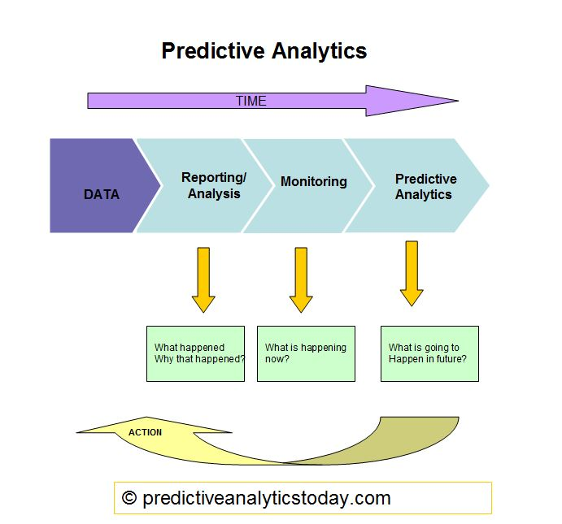
Predictive Analytics Process

Slide 4
Business process and features on Predictive Modelling
Business process on Predicting modelling
Creating the model
Testing the model
Validating the model
Evaluating the model
Features in Predicting modelling
Data analysis and manipulation
Visualization
Statistics
Hypothesis testing

Slide 5
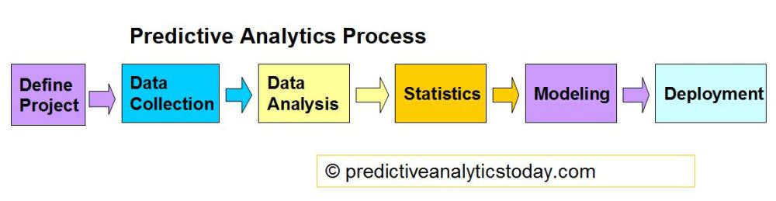
How the model work
In predictive modeling, data is collected for the relevant predictors, a statistical model is formulated, predictions are made and the model is validated (or revised) as additional data becomes available. The model may employ a simple linear equation or a complex neural network, mapped out by sophisticated software.

Slide 6
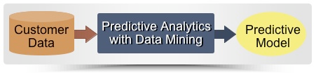
How the model work(cont.)
Here you will learn what a predictive model is, and how, by actively guiding marketing campaigns, it constitutes a key form of business intelligence. we'll take a look inside to see how a model works-
1. Predictors Rank Your Customers to Guide Your Marketing
2. Combined Predictors Means Smarter Rankings
3. The Computer Makes Your Model from Your Customer Data
4. A Simple Curve Shows How Well Your Model Works
5. Conclusions

Slide 7
Why Predictive Modelling
Nearly every business in competitive markets will eventually need to do predictive modeling to remain ahead of the curve. Predicting Modeling (also known as Predictive Analytics) is the process of automatically detecting patterns in data, then using those patterns to foretell some event. Predictive models are commonly built to predict:
Customer Relationship Management
the chance a prospect will respond to an ad
Mail recipients likely to buy
when a customer is likely to churn
if a person is likely to get sick
Portfolio or Product Prediction
Risk Management & Pricing

Slide 8
Some Predictive Models
Ideally, these techniques are widely used:
Linear regression
Logistic regression
Regression with regularization
Neural networks
Support vector machines
Naive Bayes models
K-nearest-neighbors classification
Decision trees
Ensembles of trees
Gradient boosting

Slide 9
Applications of Predictive Modelling
Analytical customer relationship management (CRM)
Health Care
Collection Analytics
Cross-cell
Fraud detection
Risk management
Industry Applications
Predictive modelling are used in insurance, banking, marketing, financial services, telecommunications, retail, travel, healthcare, oil & gas and other industries.

Slide 10
Predictive Models in Retail industry
Campaign Response Model – this model predicts the
likelihood that a customer responds to a specific campaign by
purchasing a products solicited in the campaign. The model
also predicts the amount of the purchase given response.
Regression models
Customer Segmentation
Cross-Sell and Upsell
New Product Recommendation
Customer Retention/Loyalty/Churn
Inventory Management

Slide 11
Predictive Models in Telecom industry
Campaign analytics
Based on historical data and customer profiles, it is possible to classify customers according to their likelihood of buying a product or a service through a campaign. Thus, every campaign can target the set of customers with better purchasing potential for that service/product. While these statistics-driven campaigns yield higher ROI, they also reduce the irritation caused by non-relevant communication, thereby indirectly reducing customer dissonance.
Churn modeling
The customers leaving the current company and moving to another telecom company are called churn and it can be reduced by analyzing the past history of the potential customers systematically.
Cross-selling and up-selling
A very real challenge in the telecom industry is how to increase yield from the current subscribers, or how to improve Average Revenue per User (ARPU).Cross-selling and up-selling activities can now be supported by predictive analytics, while drawing on association rules and transaction histories. Analytics driven cross-selling and up-selling campaigns provide remarkably higher returns.

Slide 12
Customer lifetime value analytics
The Customer Lifetime Value model provides the predicted yield from each customer over the customer life cycle. High priority customers can be given loyalty bonuses, preferential treatment through personalized service, better credit norms for contract subscribers etc. This analytics model may be utilized across all the functions like marketing, credit Risk, customer service and so on.
Customer segmentation
Customers are segmented both at the pre-subscription and subscription phases. At the first stage, segmentation helps reach out to prospects with higher predicted conversion rates, thereby increasing the campaign success rate as well as the ROI. During campaigns, subscribers are divided into segments to which specific campaigns are targeted.
Marketing spend optimization
A Marketing Spend Optimization model helps marketing managers and product managers take decisions based on what works and what does not. This analytics model has been of considerable benefit to the marketing function, and is hence widely used to improve marketing Return on Investment (ROI).

Slide 13
Fraud analytics
Data synthesis can help telecom service providers (TSPs) navigate their complex organizational structures and target and collect relevant fraud data when the need arises.
Provide future-proof detection techniques
Guard against habitual offenders
Ensure that pre-paid service is truly risk free
Launch profitable IP-based services
Network optimization
Network management is possibly be the most complex operation in a telecom company, the size of the investment decisions and the cost of a failure in terms of customer perception. Predictive analytics help forecast traffic patterns and peak period routing, and is thus of immense benefit in the smooth running of network operations. Analytics can ensure that network operations are run as pro-actively and scientifically, taking cognizance of changing traffic patterns.

Slide 14
Price optimization
Price optimization contributes significantly to revenue development and profitability and is especially important in the corporate sales segment, where awareness of the impact of the various pricing options offered is critical. Simulated scenarios can help evaluate the revenues at various price points. These models are widely used by product managers and finance teams.
Sales territory optimization
optimization of sales territories is necessary to align and balance workload and market potential. the focus of the model is usually on how to reach the markets efficiently, this model is used mainly for revenue and workload allocation activities. It’s also extensively used for allocation of territory for managing operations, among channel intermediaries in pre-pay business units.

Slide 15
Predictive Analytics Software
SAS Analytics
R
STATISTICA
IBM Predictive Analytics
MATLAB
Minitab

Slide 16
Thank you

